Slide 3
What does the Virgin Mary mean to you?

Slide 4
What is a pilgrimage?

Slide 5
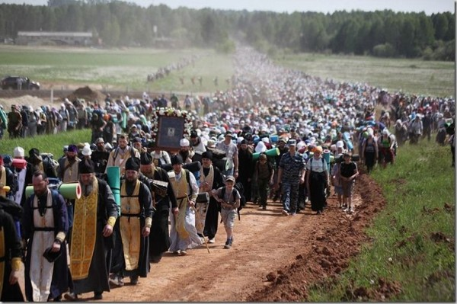
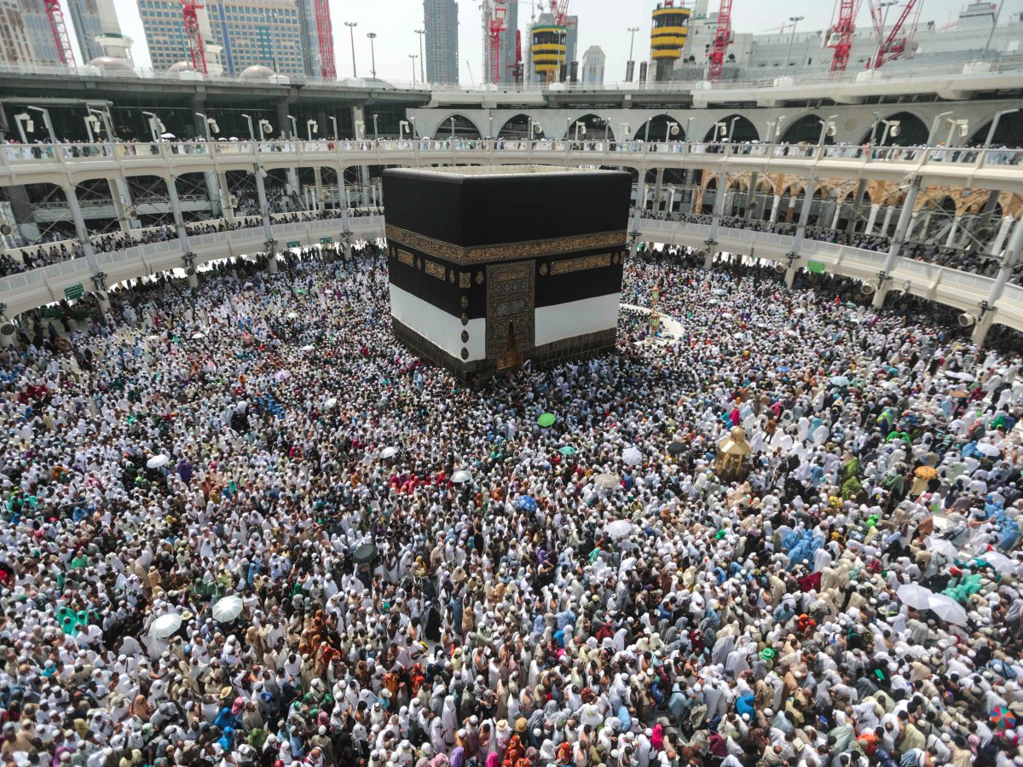
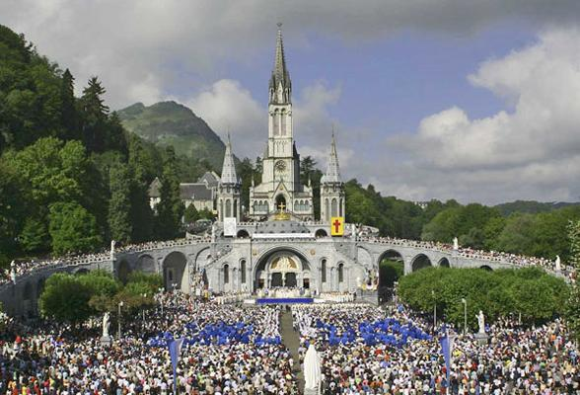
Different religions participate in pilgrimages. These are photographs of Christian and Muslim pilgrimages.

Slide 6
Why do people visit Holy sites?

Slide 7
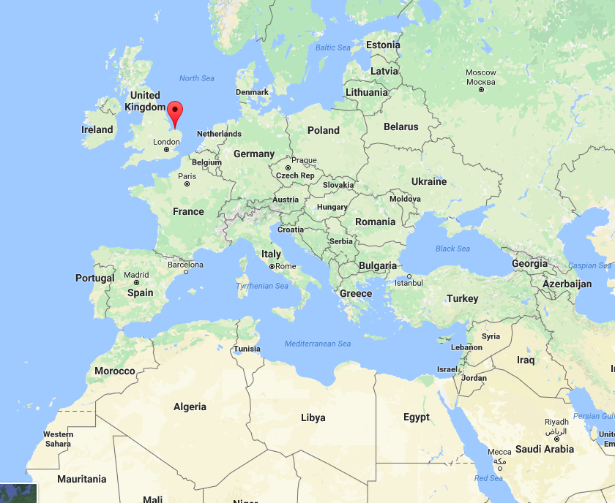
Walsingham

Slide 8
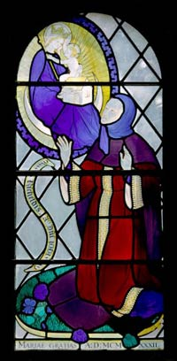
But where did it all begin for Walsingham?
Richeldis de Faverches
To Richeldis, Our Lady said: "Do all this unto my special praise and honor. And all who are in any way distressed or in need, let them seek me here in that little house you have made at Walsingham. To all that seek me there shall be given succor. And there at Walsingham in this little house shall be held in remembrance the great joy of my salutation when Saint Gabriel told me I should through humility become the Mother of God's Son."

Slide 9
The Holy House in Nazareth

Slide 10
Why do you think Mary wanted Richeldis to make a copy of the Holy House in England?

Slide 11
One of the wells at Walsingham

Slide 12
The remains of the church

Slide 13
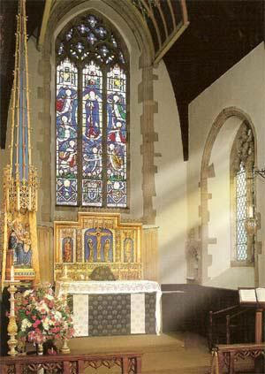
Slipper Chapel.

Slide 14
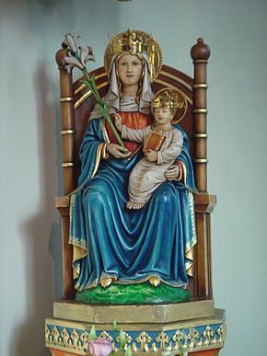
What do you think the meaning is of the objects used in the statue of the Virgin Mother?

Slide 15
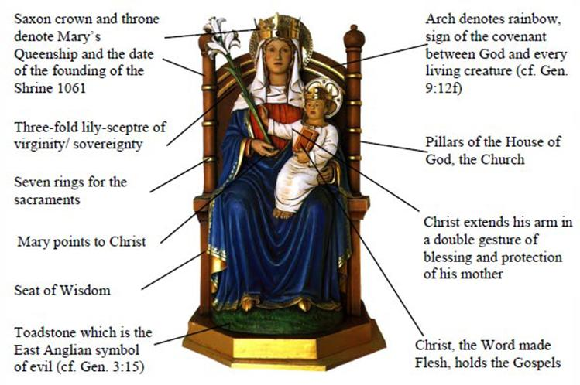

Slide 16
Walsingham today….

Slide 17
Why are pilgrimages important today?

Slide 18
Join me in praying to our mother in heaven
Hail Mary, full of grace. Our Lord is with thee. Blessed art thou among women, and blessed is the fruit of thy womb, Jesus. Holy Mary, Mother of God, pray for us sinners, now and at the hour of our death.
Amen.

