Slide 1
Our Lady of Mount Carmel
16th July 2017

Slide 2
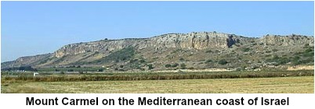

Slide 3
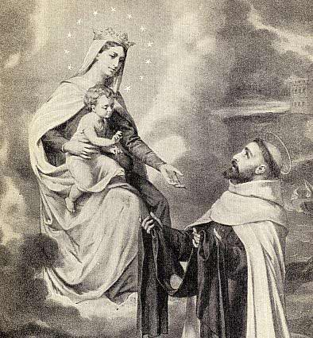

Slide 4
Mount Carmel is a mountain overlooking the plain of Galilee. It became famous when the prophet Elijah, who lived many years before Jesus, was born. Chapter 18 of the Bible's First Book of Kings tells how Elijah stood up to the 450 prophets of the false god Baal. Through his prayers, God gave Elijah the power to perform a miracle to prove that Elijah's God was the true God. This happened on Mount Carmel.
Hundreds of years later, a group of European monks who had a special devotion to Mother Mary began to live on Mount Carmel. They were called friars of the Blessed Virgin Mary of Mount Carmel.
When they began to suffer harassment for their faith, they turned to Mary for help. On July 16, 1251, Mary appeared to St. Simon and gave him the brown scapular. She promised her protection to all those who would wear the blessed habit. Many miracles proved her words.

Slide 5
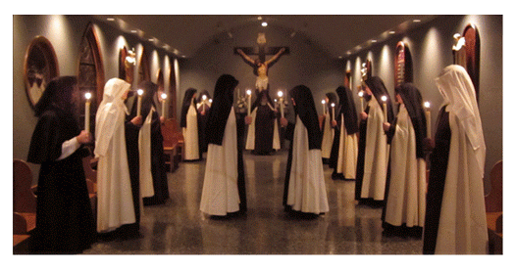
Carmelites

Slide 6
Sunday 16th July 2017
The feast celebrates the devotion that the Blessed Virgin Mary has to those who are devoted to her, and who signal that devotion by wearing the Brown Scapular. According to tradition, those who wear the scapular faithfully and remain devoted to the Blessed Virgin until death, will be granted the grace of final perseverance and be delivered from Purgatory early.

Slide 7
