Slide 1
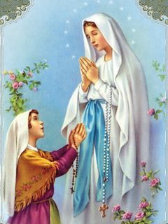
Our Lady of Lourdes

Slide 2
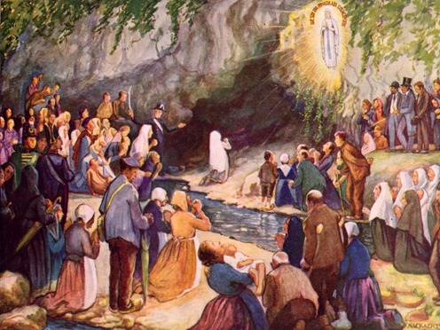
Feast Day: 11 February

Slide 3
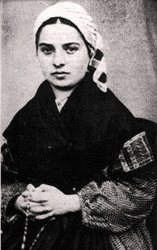
Bernadette Soubirous

Slide 4
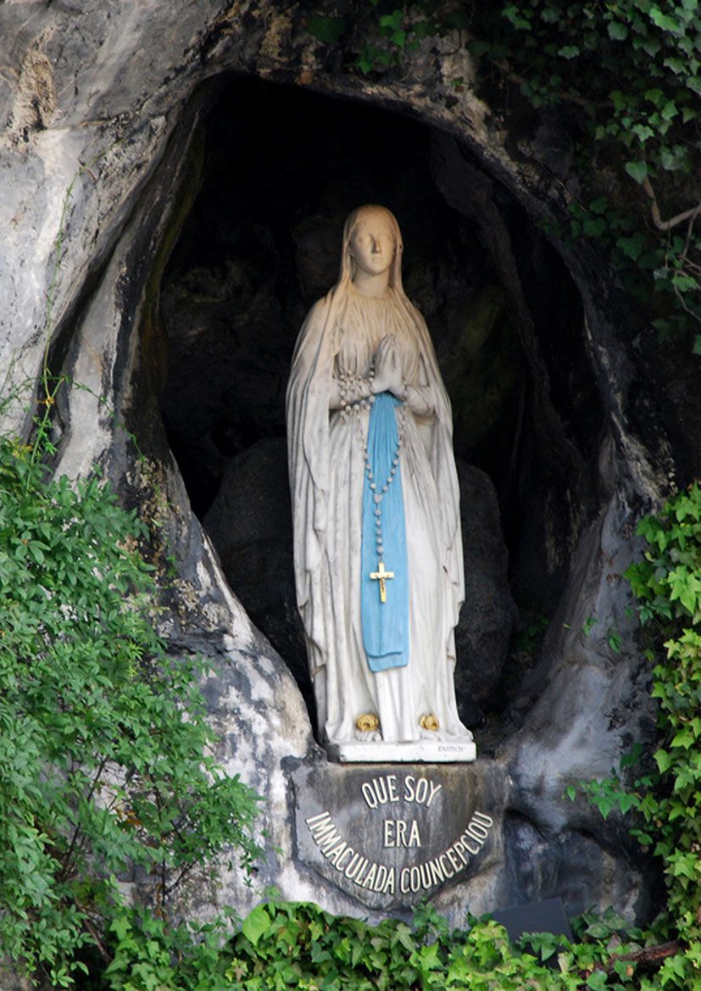
A statue of the lady referred to as
‘Our Lady of Lourdes’
was built in the place where Bernadette saw her.

Slide 5
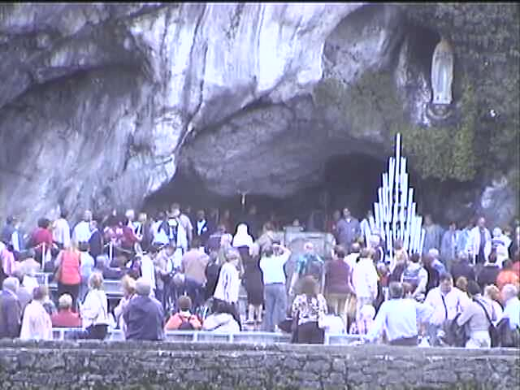
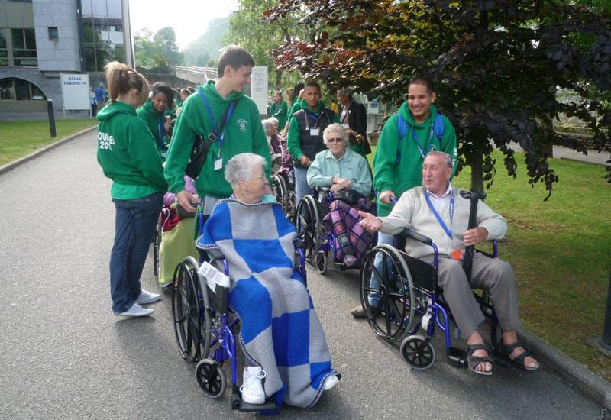
Around five million pilgrims and visitors travel to Lourdes each year, including many who are seriously ill.
They visit the site where Mary appeared to Bernadette, attend mass and pray the rosary.

Slide 6
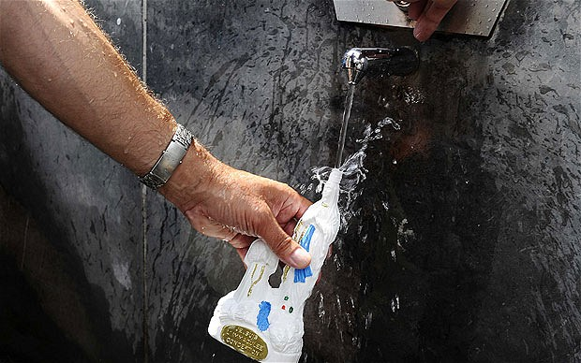
People collect the holy water from the spring to take home.

Slide 7
Let us pray to Our Lady…
Oh, Mary, Queen of Peace,
Teach us to live together in harmony
And treat each other with respect and dignity.
May our school be a model of peace for all who enter,
And we may grow together
In the love of your son, Jesus.
Amen.

Slide 8
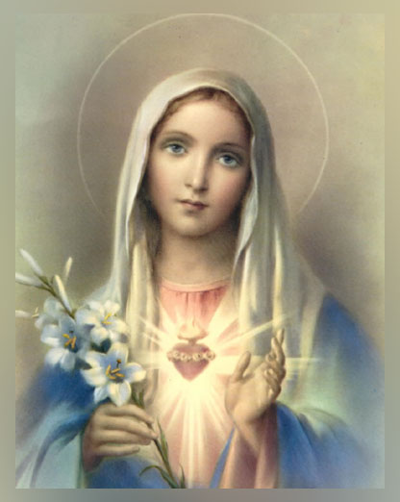
Ave Maria

